Slide 1
Which UEs are in the area?
IMSI Catching
Notes:
IMSI C

Slide 2
Who are you?
I’m IMSI “26201445484518”
Who are you?
I’m IMSI “26201445484518”
Notes:
IMSI

Slide 3
Who are you?
I’m SUCI “26201AF58918411154"
Who are you?
I’m SUCI “26201D4584598463"
Notes:
SUCI

Slide 4

SUPI
SUCI
SUCI
SUPI
ME
Serving Network
Home Network
AMF
AUSF
UDM
Notes:
SUPI Encryption

Slide 5
(I)
(I)
(I)
USIM
(III)
(II)
HE
(V)
ME
SN
(I)
(I)
3GPP AN
(II)
(I)
Non-3GPP AN
Notes:
Architecture

Slide 6
Identification Phase
Authentication and Key Agreement
Security Activation
Notes:
I -> AKA -> SA

Slide 7
AMF
AUSF
UDM
Registration Request
SUCI
Registration Request
SUCI
Registration Request
SUCI
Notes:
SUCI flow

Slide 8







Eve
Alice
Bob
Notes:
Point 2 of SBA

Slide 9
No, you’re not!
Yes!
Server
I’m Alice
I’m Bob
Eve
Bob
Notes:
Point 1 of SBA

Slide 10
No, you’re not!
Eve is a user
Server
I’m Admin
Eve
Bob
Notes:
Point 3 of SBA

Slide 11
(Hello, Key)
(Key, Certificate Verify)
(HTTP Request)
Server
Alice
(HTTP Request)
Notes:
TLS

Slide 12
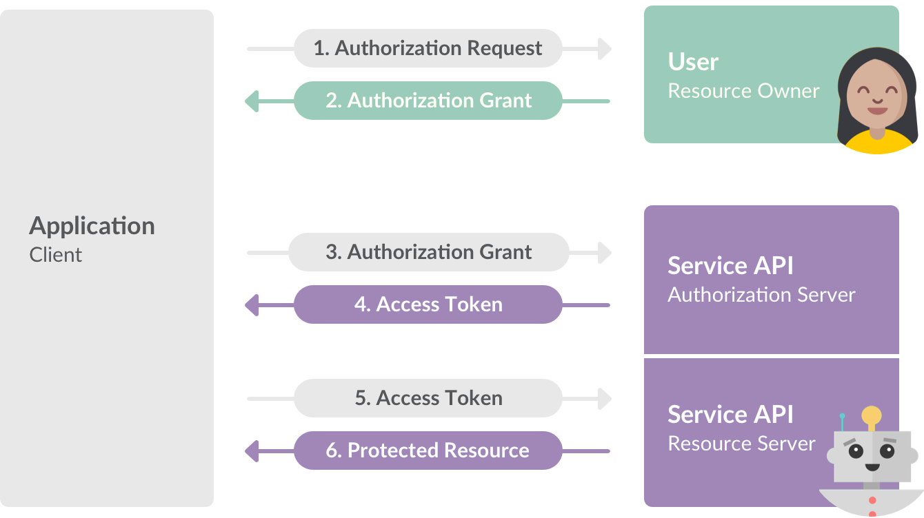
Notes:
Oauth 2.0

Slide 13
Notes:
Oauth 2.0

